Slide 1
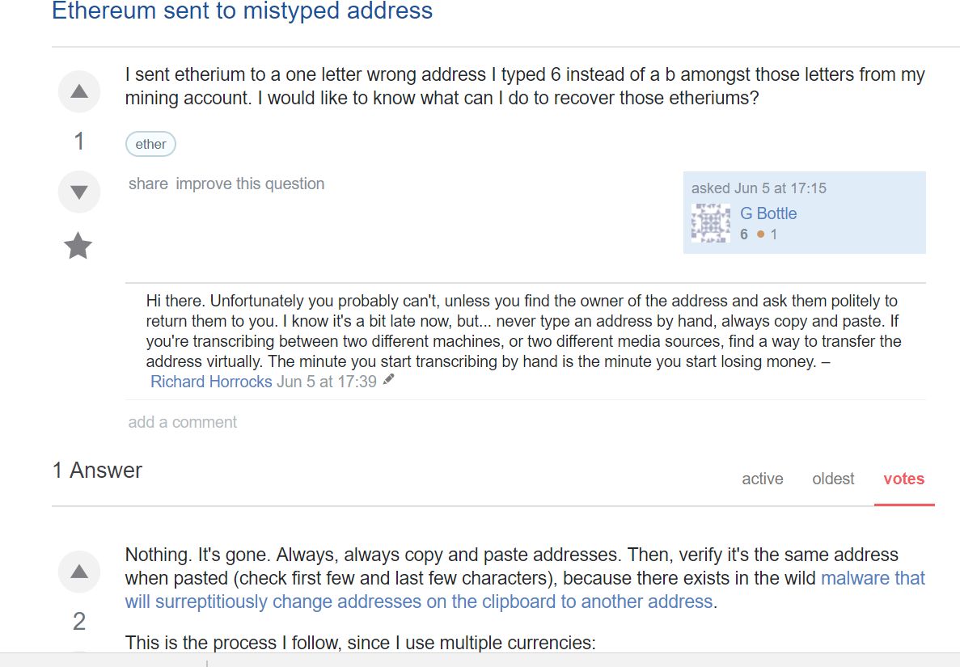
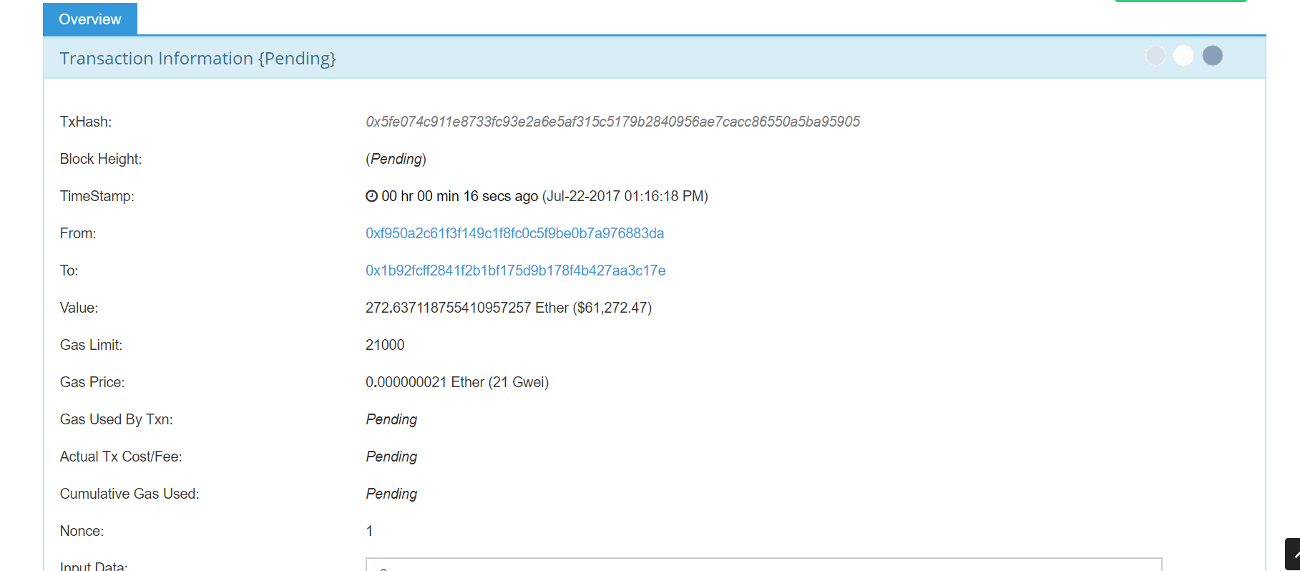


Slide 2
Smart Contract
User wallet opts-in to insurance smart contract.
User intends to send ether to the intended wallet (X), but instead, ‘fat fingers’ and sends ether to the mistake address (Y).
Right afterwards, the premium and the transaction ID for 2 is sent to the smart contract.
User realises that they have ‘fat fingered’ the address by one letter and Makes a Claim – putting in the transaction ID and the intended address
Smart contract compares the intended address to the address in the original transaction
If there is a one character difference at the contract is activated and the amount in the original transaction is sent to the intended address.
5
6
Intended address
(X)
3
4
Mistake address
(Y)
2
1
User Wallet

